Slide 1


HACKNATICS
Syed Huzaifa, Syed Daniyal, Maimoona Masood, Saqib Sheikh
“An AI agent that autonomously welcome users, delivers an interactive website demo by navigating through different pages, and intelligently responds to user’s voice commands in real time.”
01

Slide 2

Business Viability
Our Smart Agent enhances user engagement and product understanding by autonomously guiding visitors through interactive website demo and responding to real-time user’s voice commands by
showcasing products key features. It reduces the need for manual support, and delivers a modern, hands-free user’s experience. It's scalable and customizable design makes it valuable across industries aiming to boost customer interaction and automate demos efficiently..
02

Slide 3
Solution Overview
What We’re Solving
Manual website demos are outdated, repetitive, and unscalable. Users expect real-time interactivity, personalization, and simplicity — but most businesses struggle to deliver that experience efficiently.
Our Solution
We’ve built an intelligent AI agent that:
Autonomously welcomes users on your website
Navigates through key pages, offering a live, interactive tour
Listens and responds to voice commands in real-time
Delivers product education hands-free
This removes friction, reduces dependency on manual support, and increases engagement with modern, AI-powered interaction.

Slide 4
Technical Architecture Overview
Frontend Stack
Our frontend is designed with performance, scalability, and modern UI/UX in mind:
Framework: Next.js 14.2.2 Blazing-fast rendering with file-based routing.
Language: TypeScript Type-safe development for better code quality.
Styling: Tailwind CSS Utility-first CSS for rapid, responsive design.
UI Components: Lucide Icons Clean and lightweight icons for modern UIs.
State Management: useState, useEffect Efficient handling of UI logic using React Hooks.
Routing: Next.js native routing Simplified navigation and dynamic routes.
Backend Stack
Framework: FastAPI
High-performance Python web framework for APIs.
Language: Python
Widely used, scalable, and ideal for AI and automation.
Speech Tool: gTTS (Google Text-to-Speech)
Converts AI agent’s responses into human-like speech in real time.

Slide 5
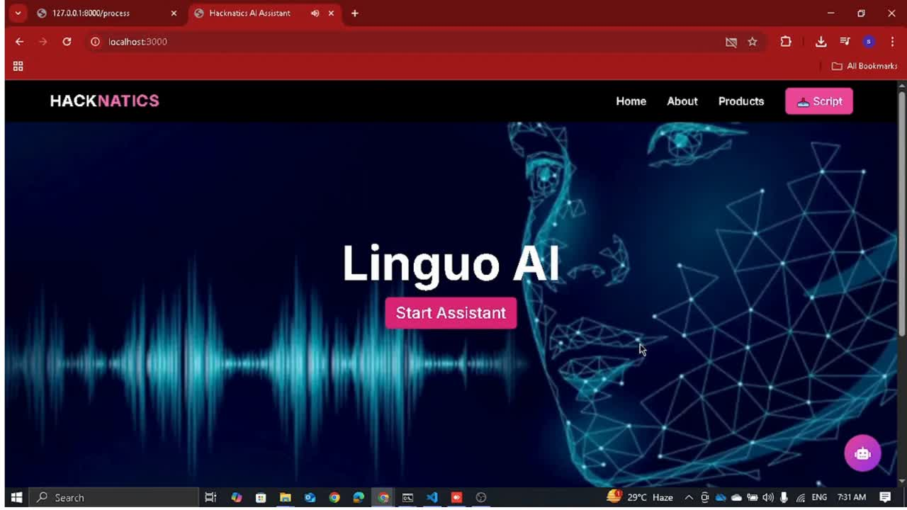
Product Demo
02

